Slide 1
Algorithm Design III
Jamie Zhang

Slide 2
Validation and Verification
Validation ensures that only data that is reasonable is accepted.
Verification is used to check that the data does not change as it is being entered.

Slide 3
Validation
range checks
length checks
type checks
presence checks
format checks
check digits

Slide 4
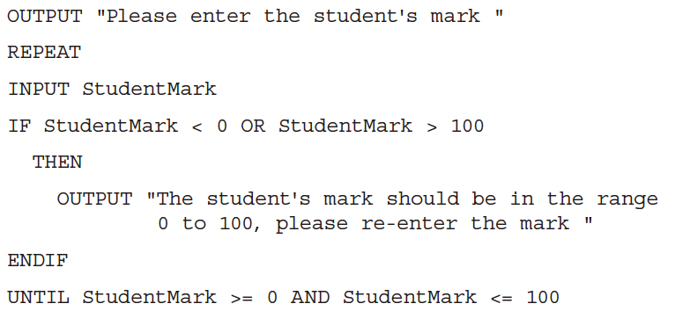
Range check
A range check checks that the value of a number is between an upper value and a lower value.

Slide 5
Range check
You are a store owner who accepts different types of cash. You can receive cash in the following denominations: 10, 20, 50, and 100. If a customer presents cash in any of these amounts, you will accept it. If the amount is not in these denominations, you will return it.
If the total amount of cash are over 1000, then end the program and return total amount of success transactions.

Slide 6
Length check
length check checks either:
-that data contains an exact number of characters
-that the data entered is a reasonable number of characters

Slide 7
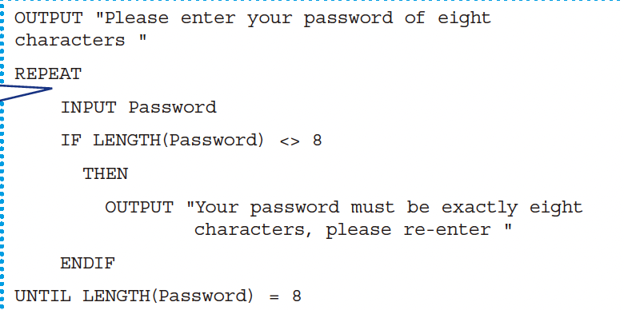
Length check

Slide 8
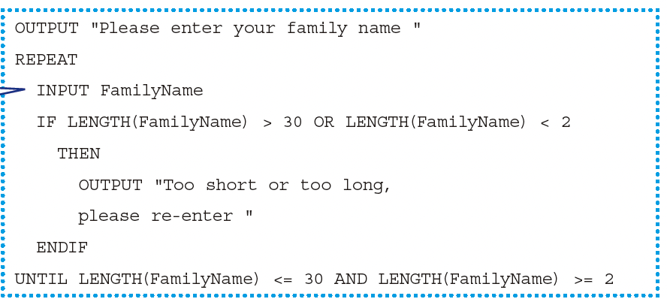
Length check

Slide 9
Length check
Write a program in pseudocode to check the length of an input string. The program should:
Accept a string from the user.
If the length of the string is greater than 5, output "String is too long."
If the length of the string is less than 3, output "String is too short."
If the length of the string is between 3 and 5 (inclusive), output "String length is acceptable."

Slide 10
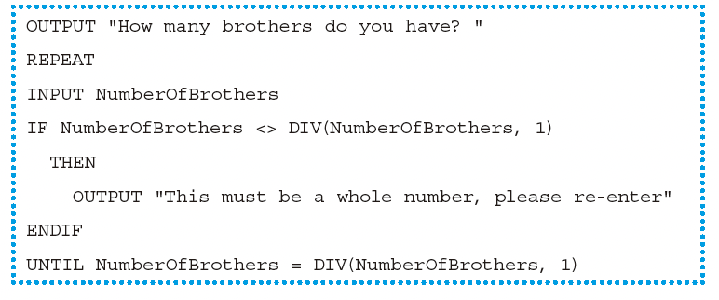
Type check
type check checks that the data entered is of a given data type

Slide 11
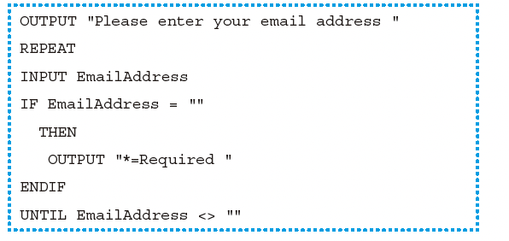
Presence check
A presence check checks to ensure that some data has been entered and the value has not been left blank

Slide 12
Format check and check digit
A format check checks that the characters entered conform to a pre-defined pattern.
A check digit is the final digit included in a code; it is calculated from all the other digits in the code.

Slide 13
In-class work
Activity 7.7

Slide 14
Verification
Verification is checking that data has been accurately copied from one source to another – for instance, input into a computer or transferred from one part of a computer system to another.
It includes Double entry and Screen/visual check.

Slide 15
Verification
For double entry the data is entered twice, sometimes by different operators.
A screen/visual check is a manual check completed by the user who is entering the data.

Slide 16
Test
A set of test data is all the items of data required to work through a solution.

Slide 17
Test
The type of test data used to do this is called normal data. Normal data should be used to work through the solution to find the actual result(s) and see if they are the same as the expected result(s).Provide a more realistic set of test data and its expected result.
Solutions also need to be tested to prove that they do not do what they are supposed not to do. In order to do this, test data should be chosen that would be rejected by the solution as not suitable, if the solution is working properly. This type of test data is called abnormal test data. (It is also sometimes called erroneous test data.)

Slide 18
Test
Extreme data are the largest and smallest values that normal data can take.
There is another type of test data called boundary data. This is used to establish where the largest and smallest values occur.

Slide 19
A joke about the QA
一个测试工程师走进咖啡厅，点了一杯卡布奇诺
一个测试工程师走进咖啡厅，点了一杯拿铁
一个测试工程师走进咖啡厅，点了一个柠檬蛋糕
一个测试工程师走进咖啡厅，点了一个煲仔饭
一个测试工程师走进咖啡厅，点了一口锅
一个测试工程师走进咖啡厅，点了一台电视机
一个测试工程师走进咖啡厅，点了一个特朗普
一个测试工程师走进咖啡厅，点了$%##^$$&*&&%(&

Slide 20
In-class work
Activity 7.11.2

Slide 21
FIFO&LIFO
stack--LIFO
queue--FIFO
DFS&BFS

